Slide 1
Chapter 11 Implementing File-Systems

Slide 2
Chapter 11: Implementing File Systems
File-System Structure
File-System Implementation
Directory Implementation
Allocation Methods 連續? link?
Free-Space Management 未使用空間管理
Efficiency and Performance
Recovery
Log-Structured File Systems
NFS
Example: WAFL File System

Slide 3
Objectives
To describe the details of implementing local file systems and directory structures
To describe the implementation of remote file systems
To discuss block allocation and free-block algorithms and trade-offs 硬碟裡面的block怎麼分配 連續? link? index?

Slide 4
File-System Structure
File structure
Logical storage unit 概念上邏輯上是連續的 實際可能不連續
Collection of related information
File system resides on secondary storage (disks)
File system organized into layers
File control block – storage structure consisting of information about a file

Slide 5
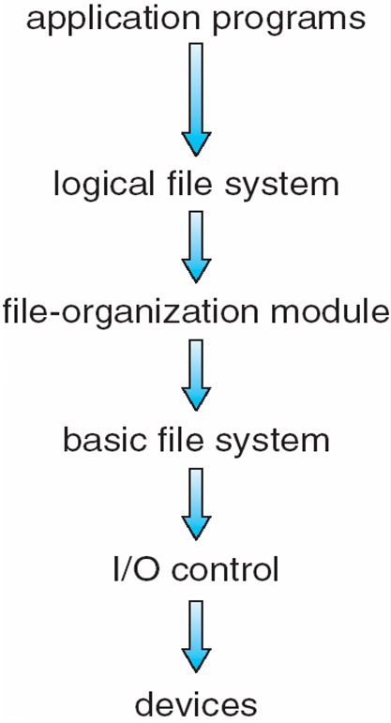
Layered File System
Notes:
階層式的 I/O Controller 就是控制IO讀寫的device

Slide 6
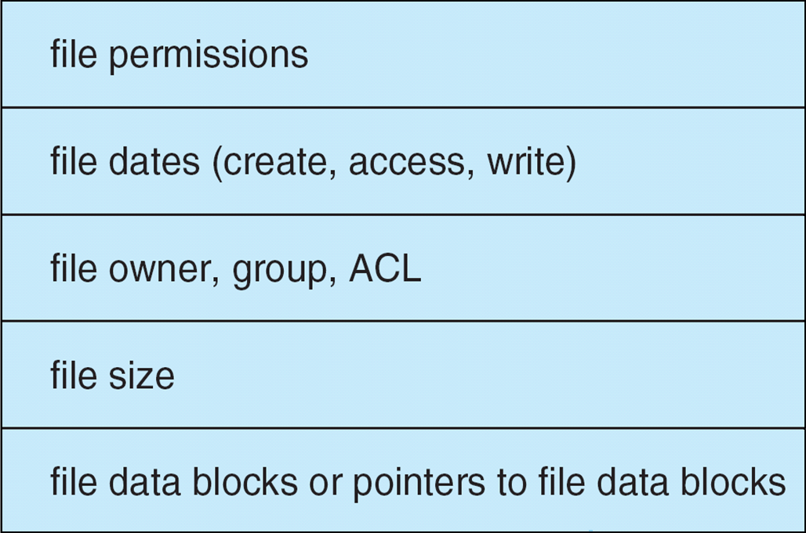
A Typical File Control Block
Notes:
ACL(Access Control List)

Slide 7
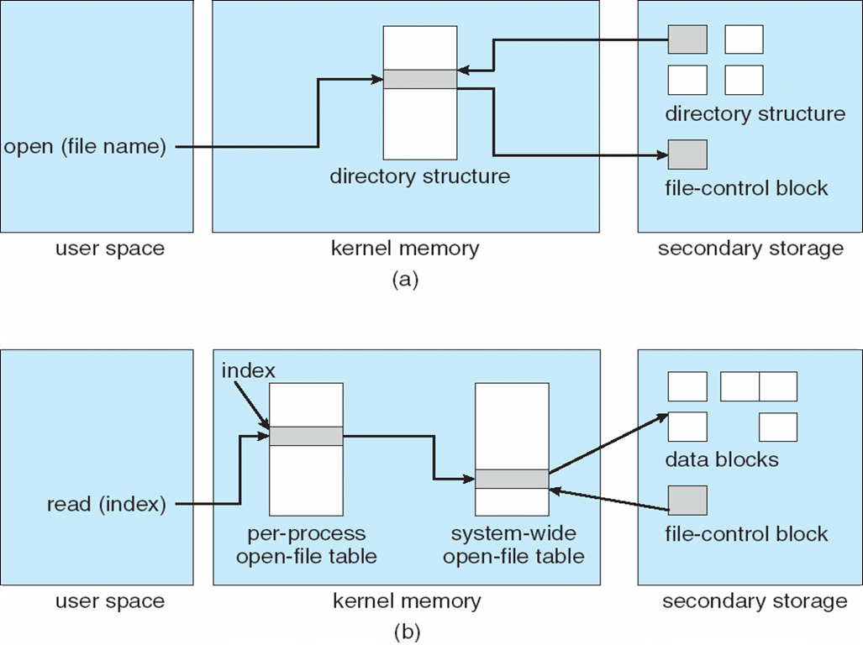
In-Memory File System Structures
The necessary file system structures provided by the OS.
1
2
3
opening a file
6
7
5
4
reading a file
Notes:
11-1 1 開機讀取目錄 2 要開檔案 3 找到對應的control block 4 放到mem 記錄到system wide ofd整個系統開啟的檔案清單 per proc ofd是單支程式自己開啟的檔案清單
5 提出read要求 到per proc ofd找 讀檔案的某個index區塊 6 再去找 4紀錄的control block 得到data block放在那邊 7去讀Data Block

Slide 8
Virtual File Systems
Modern OS must concurrently同時 support multiple types of file systems. ex remote/local fs
How does an OS allow multiple types of file systems to be integrated into a directory structure ?
To write directory and file routines for each type.
Most Operating systems provide an object-oriented way of implementing file systems, including UNIX.
The file-system implementation consists of three major layers (Figure 11.4)
The first layer is the file-system interface, based on open(), read(), write(), and close() calls (就API)
The 2nd layer is called the virtual file system (VFS) layer

Slide 9
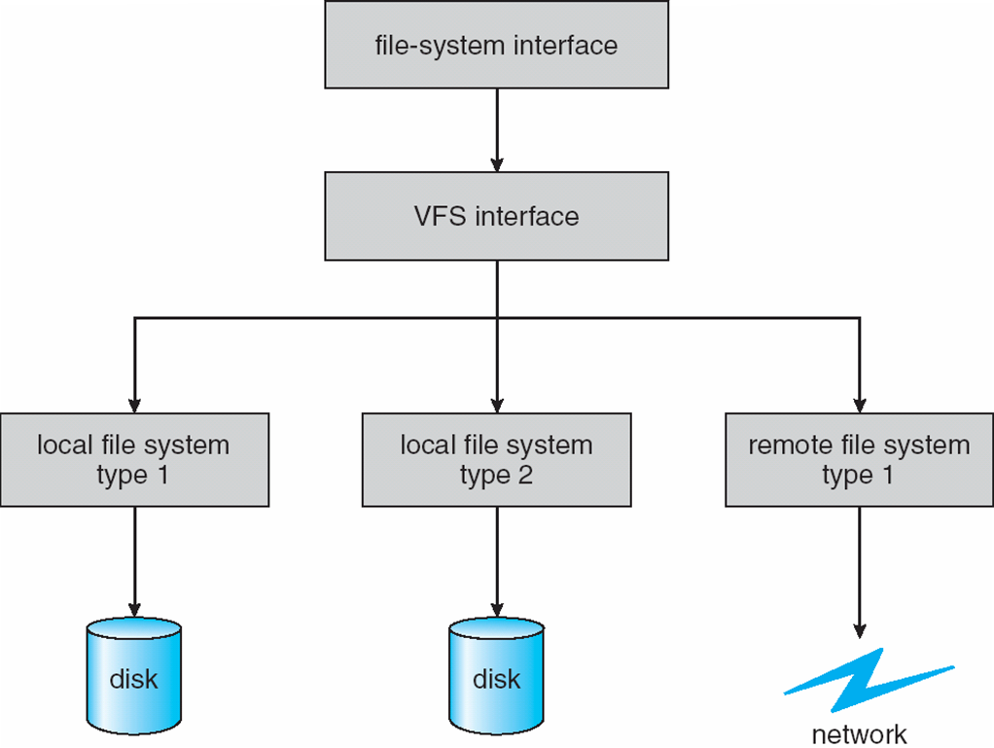
Schematic View of a Virtual File System
Open()
Read()
Write()
Close()
1st Layer
2nd Layer
3rd Layer

Slide 10
Virtual File Systems
The VFS serves two important functions
It separates file-system-generic operations from their implementation by defining a clean VFS interface. 只要會用介面 不用知道實作細節
It provides a mechanism for uniquely representing a file throughout a network. 檔案跨網路的ID
The VFS is based on a file-representation structure, called a vnode, that contains numerical designator指定者 for a network-wild unique廣域唯一性 file.

Slide 11
Virtual File Systems
Unix inodes are unique only within a single file system 相對於vnode是跨網路唯一
The kernel maintains one vnode structure for each active node (file or directory)
The VFS 要能 distinguishes區隔 local files from remote files, and local files are further distinguished according to their file-system types.

Slide 12
Virtual File Systems
VFS allows the same system call interface (the API) to be used for different types of file systems.
The API is to the VFS interface, rather than any specific type of file system.
The 3rd layer implements the file-system type or the remote-file-system protocol.
Notes:
11-2

Slide 13
Virtual File Systems
The VFS architecture in Linux defines four major object types
The inode object, represents an individual file
The file object, represents an open file
The Superblock object, represents an entire file system
The dentry object, represents an individual directory entry.
也就是有OO風格

Slide 14
Directory Implementation
The selection of directory-allocation and directory-management algorithms affects the efficiency, performance, and reliability of the file system 分配/管理資料夾空間
Linear list of file names with pointer to the data blocks.
simple to program
time-consuming to execute Linear要依序找過去>慢
Hash Table – linear list stores the directory entries, but a hash data structure is also used.
decreases directory search time
collisions – situations where two file names hash to the same location > 用Linear Linked List
fixed size
Notes:
Lin List > 例如說10個檔案 各有一個file control block 然後每個control block有一個Link指向真正的空間位址 Hash則是因為透過Hash Function分類 所以同樣可以直接用Hash Function直接轉換得到位置 >可做到direct access

Slide 15
Allocation Methods
An allocation method refers to how disk blocks are allocated for files:
Contiguous要連續 allocation
Linked allocation ex Linked List
Indexed allocation
連續 缺:一定要連續空間 零碎小空間就無法
優 可Direct Access因為直接start+shift
Link List 要找中間的都要從頭Linear循序找
Index 把所有的block的index 蒐集起來放到block
Notes:
硬碟的空間一個個區塊叫做block

Slide 16
Contiguous Allocation
Each file occupies a set of contiguous blocks on the disk
Simple – only starting location (block #) and length (number of blocks) are required
Random access
Wasteful of space (dynamic storage-allocation problem), external fragmentation
Files cannot grow

Slide 17
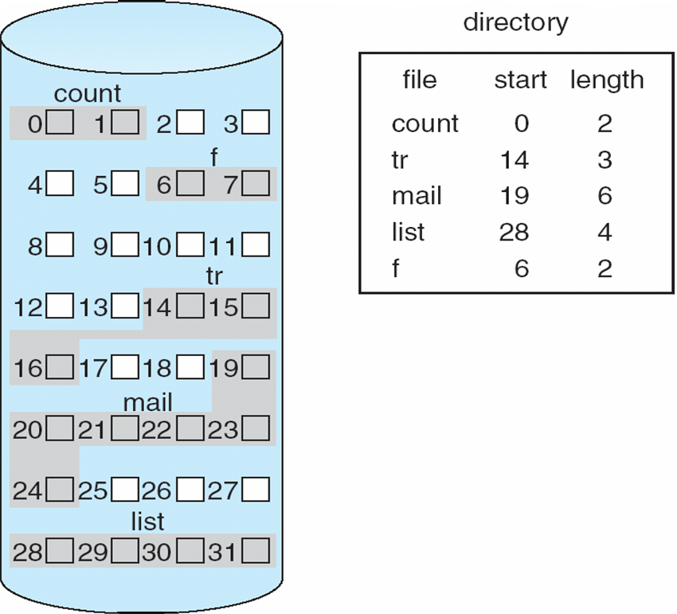
Contiguous Allocation of Disk Space
Notes:
11-3 可以感覺到白色留空比較難分配

Slide 18
Extent-Based Systems
Many newer file systems use a modified contiguous allocation scheme
Extent-based file systems allocate disk blocks in extents一個範圍
An extent is a contiguous block of disks 連續的幾個區塊
Extents are allocated for file allocation
A file consists of one or more extents.
The location of a file’s blocks is then recorded as a location and a block count, plus a link to the first block of the next extent.
The commercial Veritas File System uses extents to optimize performance. It is a high-performance replacement for standard UNIX UFS.
Notes:
前面是要全部連在一起 這邊是小塊小塊本身連在一起就可以 每塊之間可以分開 要記錄每個extent的起始位置和長度 extent尾巴要記錄下一個extent在哪裡 用pointer串起來 很像是linked list

Slide 19
Linked Allocation
Each file is a linked list of disk blocks: blocks may be scattered anywhere on the disk.
block =
pointer
pointer
pointer
pointer
Notes:
連續或不連續都可以 因為都用pointer連起來

Slide 20
Linked Allocation (Cont.)
Simple – need only starting address
Free-space management system – no waste of space 沒有fragmentation 每個free都能用
Some disadvantages
No random access (only for sequential access files)
Space required for pointers, If a pointer requires 4 bytes out of a 512 bytes block, 0.78 percent is used for pointers pointer通常4 bytes
Clusters (k blocks)
Reliability Issue
Notes:
可以用double linked list(除了往下一個指還會往上個指)增加可靠度 但是使用空間會增加

Slide 21
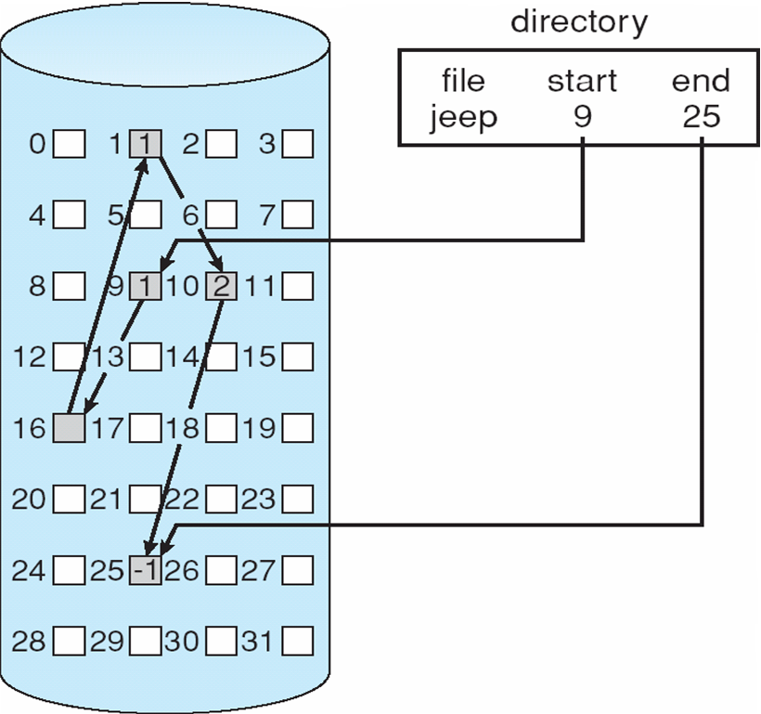
Linked Allocation
10
16
25
1
Notes:
只記 start end

Slide 22
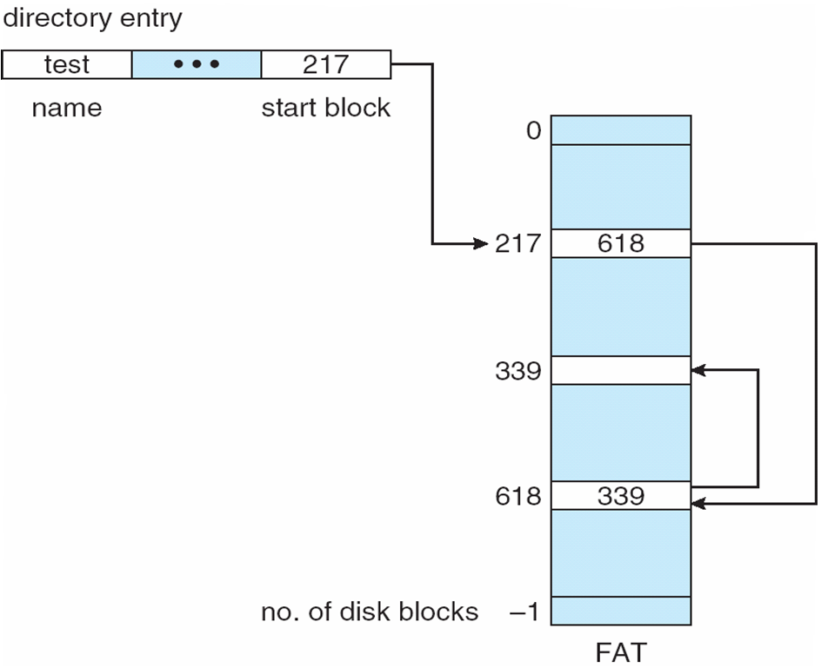
File-Allocation Table
An important variation on linked allocation is the use of a file-allocation table (FAT)
The FAT allocation scheme can result in a significant number of disk head seeks, unless the FAT is cached.
Notes:
link list的改良版 FAT是把每一個block裡面的pointer記錄到file Aloc table table可以放在mem 讀取速度可以更快 原本是pointer是放在block裡再放到硬碟 稍慢
dir entry只要記錄start block

Slide 23
Indexed Allocation
Brings all pointers together into the index block.
Logical view.
blocks
index table
Notes:
FAT是把所有pointer整理到一個table 只有一個 所有檔案共用 index是把所有pointer整理放到一個block 可以放在disk的任何地方

Slide 24
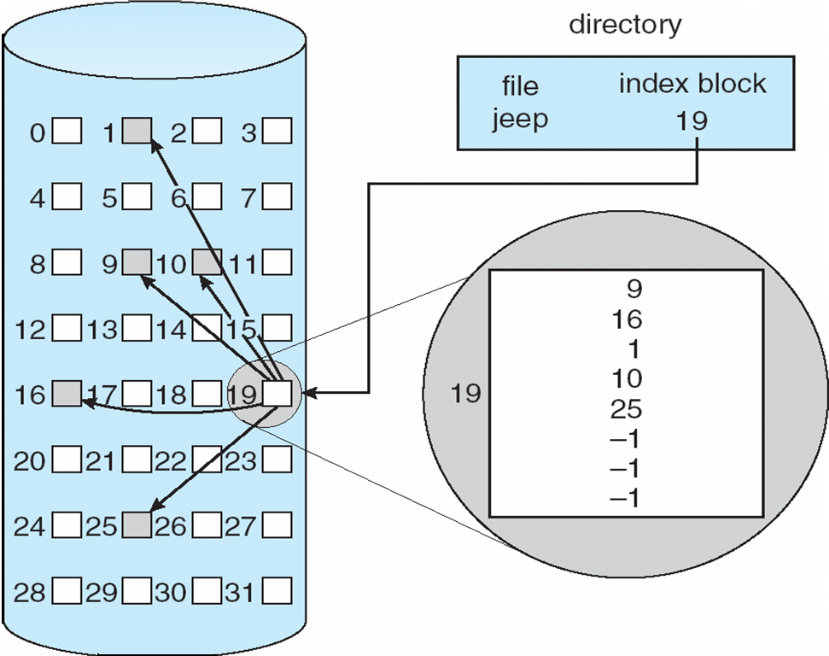
Example of Indexed Allocation
Notes:
同前頁說明 size要擴大 就填下面的-1

Slide 25
Indexed Allocation (Cont.)
Need index table
Random access 可以抓任何一個地方
Dynamic access without external fragmentation, but have overhead of index block.
Mapping from logical to physical in a file of maximum size of 256K words and block size of 512 words(0.5K).
Only 1 block is needed for index table. 256K/0.5K = 512 blocks 剛好用到一個block 512

Slide 26
Indexed Allocation – Mapping (Cont.)
Mapping from logical to physical in a file of unbounded length (block size of 512 words).
大檔需要大量index block
Linked scheme – Link blocks of index table (no limit on size).
可以把所有index block用link串起來

Slide 27
Indexed Allocation – Mapping (Cont.)

outer-index
index table
File
Notes:
也可以用兩階 多個index block組合起來的table 每個index block的index再抽一層出來成為outer index 找的時候就out ind > ind tabl > fli

Slide 28
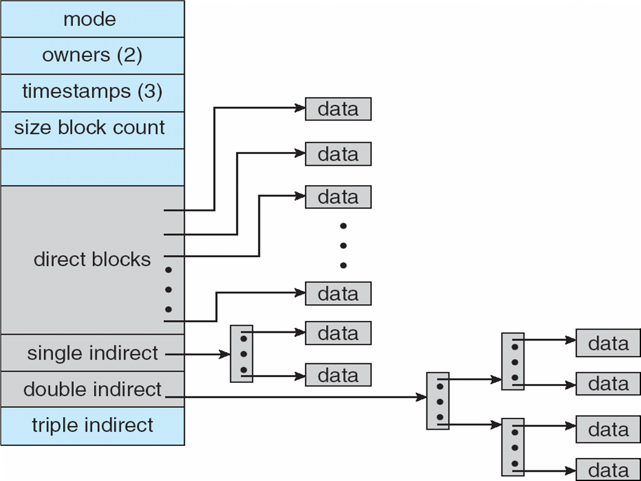
Combined Scheme: UNIX (4K bytes per block)
Notes:
左邊就是inode 的結構 direct block就是抓硬碟的資料位置 >大小有限 超出時動用底下indirect 拉出去第二階去記錄 甚至3 4 5階 就可以支援

Slide 29
Free-Space Management
Bit vector (n blocks)
0
1
2
i
n-1
…
0 ⇒ block[i] free
1 ⇒ block[i] occupied

bit[i] =

Slide 30
Free-Space Management (Cont.)
Bit map requires extra space 法一
Example:
block size = 2¹² bytes(就4Kbytes)
disk size = 2³⁰ bytes (1 gigabyte)
n = 2³⁰/2¹² = 2¹⁸ bits (or 32K bytes)
Easy to get contiguous files …. 00011111111000….
Linked list (free list) 法二
Cannot get contiguous space easily
No waste of space
Notes:
第二大點 是說 bitmap的機制 在如果想要用連續的block分配的機制 要找那些區塊連續就很好找

Slide 31
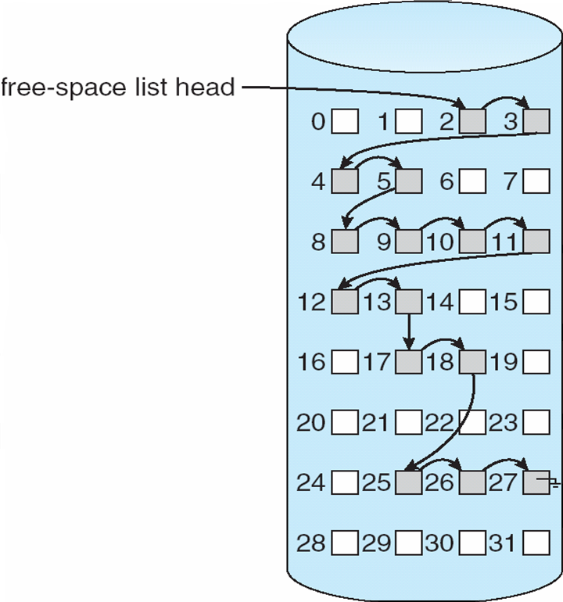
Linked Free Space List on Disk

Slide 32
Free-Space Management (Cont.)
Grouping法三: stores the addresses of n free blocks in the first free block. A block has n entries.
The first n-1 of these blocks are actually free.
The last block contains the addresses of another n free blocks, and so on.
Counting法四: keep the address of the first free block and the number (n) of free contiguous blocks that follow the first block.
Address 1, n1 (2,3)
Address 2, n2, (8,5)
Address 3, n3, (17,2) …
Notes:
法三grouping 1~n-1 n->指向另一個n(1~n-1 n-<指向另一個n)

Slide 33
Free-Space Management (Cont.)
Need to protect:
Pointer to free list
Bit map
Must be kept on disk避免當機停電消失
Copy in memory and disk may differ但是可以放一個copy在mem 加速
Cannot allow for block[i] to have a situation where bit[i] = 1 (occupied) in memory and bit[i] = 0 (free) on disk
Solution:
Set bit[i] = 1 in disk
Allocate block[i]
Set bit[i] = 1 in memory

Slide 34
Efficiency and Performance
Efficiency
The Efficient use of disk space depends heavily on the disk allocation and directory algorithms
UNIX inodes are preallocated on a volume. Even a “empty” disk has a percentage of it space lost to inodes.
By preallocating, the inodes and spreading them across the volume, we improve the file system’s performance. --- Try to keep a file’s data block near that file’s inode block to reduce the seek time.
The type of data kept in file’s directory (or inode) entry also require consideration
“Last write date”
“Last access date”
Notes:
11-7 1-2點如果在鄰近的話 在磁碟上的位置就容易在同一圈 不會需要移動磁頭 機械式動作特別花時間

Slide 35
Efficiency and Performance
Performance
disk cache – separate section of main memory for frequently used blocks disk常用的存到cache
free-behind and read-ahead – techniques to optimize sequential access
Free-behind removes a page from the buffer as soon as the next page is requested.
With read-ahead, a requested page and several subsequent pages are read and cached.
improve PC performance by dedicating section of memory as virtual disk, or RAM disk
一部分記憶體當作硬碟用 但要做到disk的同步
Notes:
read-ahead 讀一個先讀後面幾個一起讀進來 後面有用到就賺到幾個cycle的時間 沒用到就丟掉 跟CPU register ALU pipeline滿像的

Slide 36
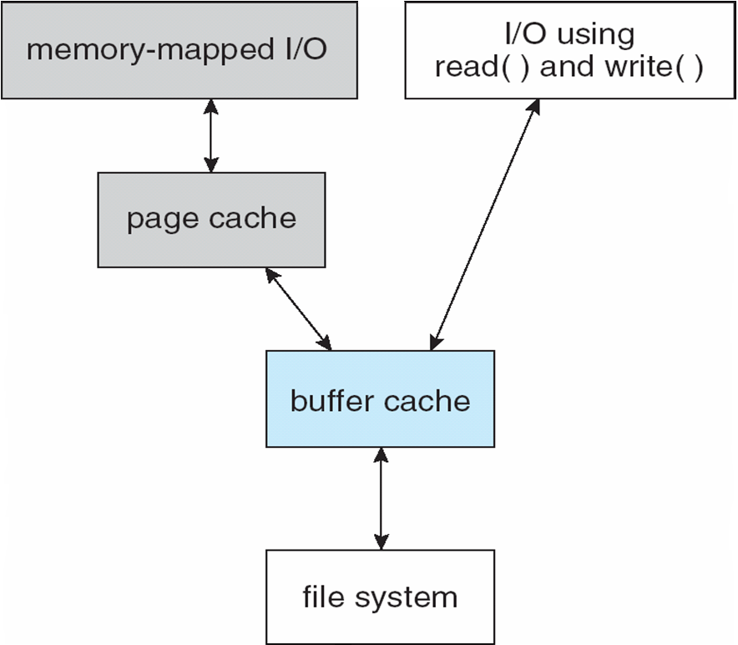
Page Cache
A page cache caches pages rather than disk blocks using virtual memory techniques
Memory-mapped I/O uses a page cache
Routine I/O through the file system uses the buffer (disk) cache
Double caching
有可能cache兩次
沒有做到unify
I/O Without a Unified Buffer Cache
Notes:
如圖

Slide 37
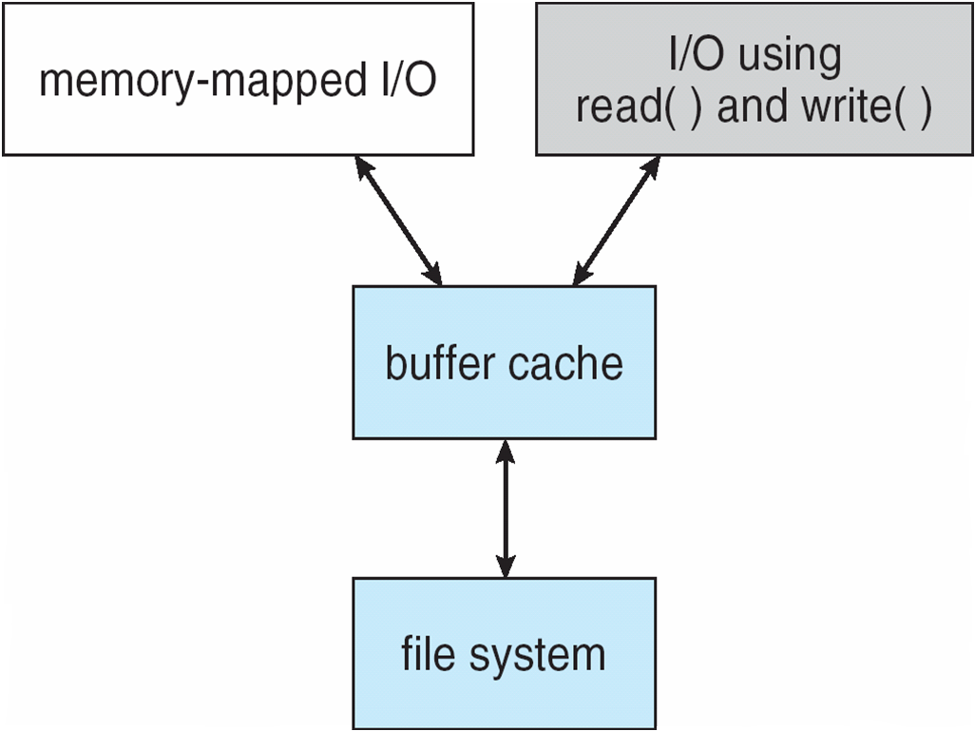
Unified Buffer Cache
A unified buffer cache uses the same page cache to cache both memory-mapped pages and ordinary file system I/O
I/O Using a Unified Buffer Cache
Notes:
這裡單一化的作法 只用page cache 沒有用disk cache 11-7 end

Slide 38
Recovery
Consistency checking – compares data in directory structure with data blocks on disk, and tries to fix inconsistencies 一致性
Use system programs to back up data from disk to another storage device (floppy disk磁片 少用, magnetic tape, other magnetic disk, optical)
Recover lost file or disk by restoring data from backup

Slide 39
Log Structured File Systems
Log structured file systems record each update to the file system as a transaction
All transactions are written to a log
A transaction is considered committed once it is written to the log
However, the file system may not yet be updated
The transactions in the log are asynchronously written to the file system
When the file system is modified, the transaction is removed from the log
If the file system crashes, all remaining transactions in the log must still be performed
Notes:
11-8

Slide 40
The Sun Network File System (NFS)
An implementation and a specification of a software system for accessing remote files across LANs (or WANs)
The implementation is part of the Solaris and SunOS operating systems running on Sun workstations using an unreliable datagram protocol (UDP/IP protocol and Ethernet)
Interconnected workstations viewed as a set of independent machines with independent file systems不一定要一樣, which allows sharing among these file systems in a transparent manner
Notes:
資料報^{[1]}（英語：Datagram）是在封包交換網路中的最小傳輸資料單元。是一種無連接式通訊方法，它與虛擬電路構成了分組交換的兩種主要傳輸方式。
transparent: 操作網路檔案系統看其他台電腦的檔案 好像跟本機操作一樣 不用有特別的操作

Slide 41
NFS (Cont.)
A remote directory is mounted over附加到 a local file system directory 一個local可以配多個remote
The mounted directory looks like an integral整體的 subtree of the local file system, replacing the subtree descending from the local directory
Specification規格 of the remote directory for the mount operation is nontransparent; the host name of the remote directory has to be provided至少要給對像電腦名稱 這步驟非透明 但後續連接後的操作就透明了
Files in the remote directory can then be accessed in a transparent manner
Subject to access-rights accreditation鑑定, potentially any file system (or directory within a file system), can be mounted remotely on top of any local directory

Slide 42
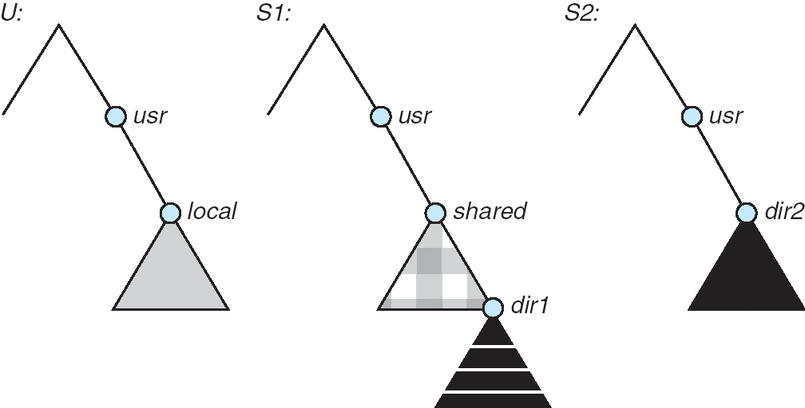
NFS (Cont.)
Consider the following file system where the triangles represent subtrees of directories that are of interest.
Three independent file systems of machines: U, S1, and S2
Notes:
S1 S2是remote FS 其他電腦

Slide 43
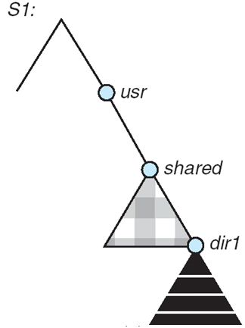
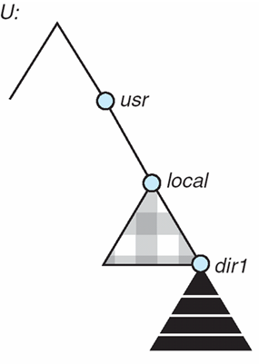
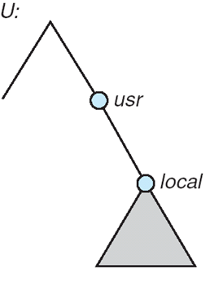
NFS (Cont.)
The effect of mounting S1:/user/shared over U:/user/local
The machine U can access any file within the dir1 directory using prefix /usr/local/dir1.
The original /usr/local on that machine is no longer visible.
Notes:
local 就變share了!!!

Slide 44
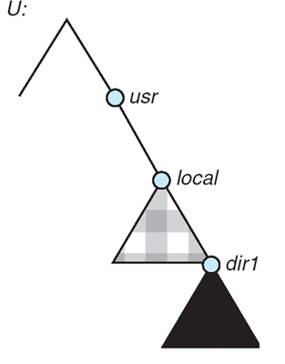
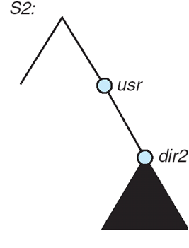
NFS (Cont.)
Cascading mounts. 可以一個接一個mount
mounting S2:/user/dir2 over U:/user/local/dir1 which is already remotely mounted from S1.
Users can access files within the dir2 on U using prefix /usr/local/dir1.
Notes:
ok 原檔案系統的路徑名稱會保留 transparent可以感覺到 是在原本的路徑名稱底下操作 但是已經是在抓其他電腦的檔案了

Slide 45
NFS (Cont.)
User mobility
If a shared file system is mounted over a user’s home directories on all machines in a network, the user can log into any workstation and get his home environment.
Notes:
每一台都把特定共用的資料夾 mount到本機 那檔案丟上去 當然全部電腦都可以看的到 可以做到user mobility 也就是說 在工作電腦登出後 到家裡電腦登入 一樣看的到檔案

Slide 46
NFS (Cont.)
One of the design goals of NFS was to operate in a heterogeneous不同成分形成的 environment of different machines, operating systems, and network architectures;
the NFS specifications規格 independent of these media
This independence is achieved through the use of RPC primitives built on top of an External Data Representation (XDR) protocol used between two implementation-independent interfaces

Slide 47
NFS (Cont.)
The NFS specification distinguishes between the services provided by a mount mechanism and the actual remote-file-access services.
Accordingly, two separate protocols are specified for these services:
a mount protocol and
an NFS protocol for remote file accesses.
The protocols are specified具體 as sets of RPCs.
These RPCs are the building blocks used to implement transparent remote file access.

Slide 48
NFS Mount Protocol
The mount protocol establishes initial logical connection between a server and a client.
A mount operation includes
name of remote directory to be mounted and
name of server machine storing it
Mount request is mapped to corresponding RPC and forwarded to mount server running on server machine
The server maintains an export list – specifies local file systems that server exports for mounting, along with names of machines that are permitted to mount them

Slide 49
NFS Mount Protocol
In Solaris, this list is the /etc/dfs/dfstab, which can be edited only by a supervisor.
Any directory within an exported file system can be mounted by an accredited machine.
A component unit is such a directory.
Following a mount request that conforms to its export list, the server returns a file handle — a key for further accesses
In UNIX terms, the file handle consists of a file-system identifier, and an inode number to identify the mounted directory within the exported file system
The mount operation changes only the user’s view and does not affect the server side
Notes:
accredit 相信認可 conform vt. 使遵照；使符合，使一致

Slide 50
NFS Protocol
The NFS protocol provides a set of RPCs for remote file operations.
The procedures support the following operations:
searching for a file within a directory
reading a set of directory entries
manipulating links and directories
accessing file attributes
reading and writing files
These procedures can be invoked only after a file handle for the remotely mounted directory has been established.

Slide 51
NFS Protocol
NFS servers are stateless; Servers do not maintain information about their clients from one access to another. Each request has to provide a full set of arguments.
Every NFS request has a sequence number, allowing the server to determine if a request is duplicated or missed. 是否有被處理過 或漏掉的
Modified data must be committed to the server’s disk before results are returned to the client (lose advantages of caching)
The NFS protocol does not provide concurrency-control mechanisms 較不知支援同時讀寫

Slide 52
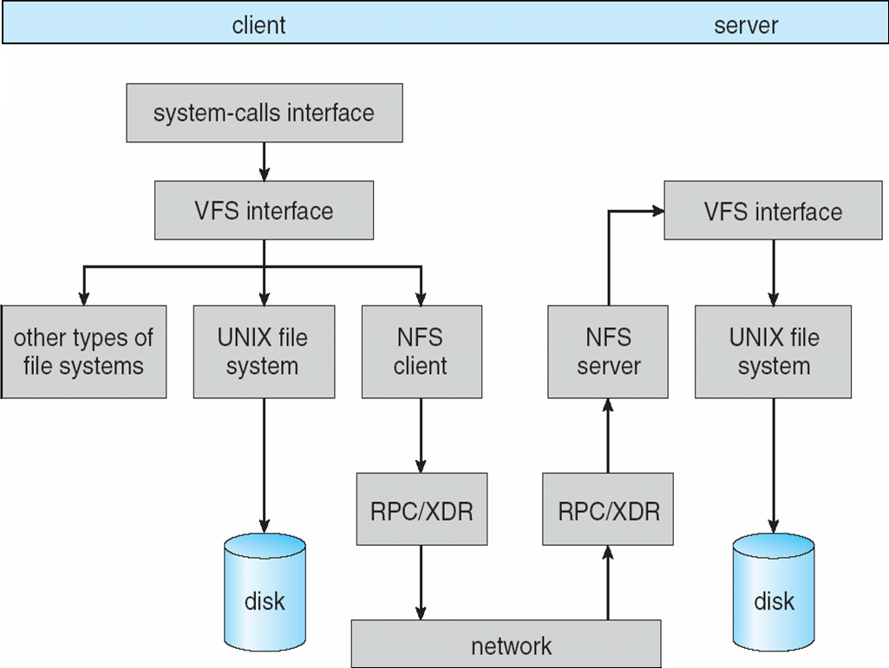
Schematic View of NFS Architecture
Notes:
左Client 右Server 中間下方是NFS 溝通 先mounting過 走RPC XDR RPC primitives built on top of an External Data Representation (XDR) protocol

Slide 53
Three Major Layers of NFS Architecture
UNIX file-system interface (based on the open, read, write, and close calls, and file descriptors)
Virtual File System (VFS) layer – distinguishes local files from remote ones, and local files are further distinguished according to their file-system types
The VFS activates file-system-specific operations to handle local requests according to their file-system types
Calls the NFS protocol procedures for remote requests
NFS service layer – bottom layer of the architecture
Implements the NFS protocol

Slide 54
An illustration of NFS Architecture
NFS is integrated into the OS via a VFS.
Let’s trace how the operation on an already open remote file is handled.
The client initiates the operation with a regular system call. 如 read write
The OS layer maps this call to a VFS operation on the appropriate vnode.
The VFS layer identifies the file as a remote one and invokes the appropriate NFS procedure.
An RPC call is made to the NFS service layer at the remote server. This call is reinjected再注入 to the VFS layer on the remote system, which finds that it is local and invokes the appropriate file system operation.
This path is retraced to return the results.
Notes:
11-11

Slide 55
Schematic View of NFS Architecture
Notes:
11-11

Slide 56
NFS Path-Name Translation
Path-name translation in NFS involves the parsing of a path name such as /usr/local/dir1/file.txt into separate directory entries, or components: (1) usr, (2) local, and (3) dir1.
Performed by breaking the path into component names and performing a separate NFS lookup call for every pair of component name and directory vnode.
Once a mount point is crossed(跨過mount point代表要跨到遠端了), every component lookup causes a separate RPC to the server.
To make lookup faster, a directory name lookup cache on the client’s side holds the vnodes for remote directory names

Slide 57
NFS Remote Operations
Nearly one-to-one correspondence between regular UNIX system calls for file operations and the NFS protocol RPCs (except opening and closing files). unix 和 nfs rpc操作介面方法近相同
A remote file operation can be translated翻轉譯 directly to the corresponding RPC.
NFS adheres黏附 to the remote-service paradigm範例, but employs buffering and caching techniques for the sake of performance.
There are two caches: the file-attribute檔案屬性 cache and the file-blocks檔案內容 cache.
Notes:
adhere 黏附 paradigm 範例

Slide 58
NFS Remote Operations
When a file is opened, the kernel checks with the remote server whether to fetch or revalidate the 先看cached attributes對.
The 才可以用cached file blocks are used only if the corresponding cached attributes are up to date.
The attribute cache is updated whenever new attributes arrive from the server.
Cached attributes are discarded拋棄 after 60 seconds.
Both read-ahead and delayed-write techniques are used between the server and the client.
Clients do not free delayed-write blocks until the server confirms that the data have been written to disk.

Slide 59
網路文件共享系統(Common Internet File System；CIFS)原先被稱為伺服器訊息區塊(Server Message Block；SMB)，該技術使得網路上的機器得以共享文件、周邊機器(如印表機)、串接阜等資源，也提供通過授權的程序間溝通
Network appliance類似某種比較高等的網路設備 is a generic term for a system that provides various networking services that require deep packet inspection and packet processing. Services may include firewall, intrusion detection, load balancing, network monitoring, VPN services, and WAN optimization.

Slide 60
Example: WAFL File System
Disk I/O has a huge impact on system performance.
Some file systems are general purpose, others are optimized for specific tasks,
The WAFL (“Write-anywhere file layout”) file system from Network Appliance, is a powerful file system optimized for random writes. 原本是對同一位置讀寫 所以磁頭header要移回磁碟的track的位置花時間 random則是找目前附近空的就寫
Used on Network Appliance “Files” – distributed file system appliances
Serves up NFS, CIFS, http, ftp protocols
Random I/O optimized速度更快, write optimized

Slide 61
https://kknews.cc/zh-tw/code/oprnlmq.html
冷知識：什麼是SMB/CIFS/Samba2018-08-31 由 田丁醬 發表于程式開發、什麼是SMB/CIFS？SMB（Server Message Block，又稱Common Internet File System（CIFS））是由微軟開發的一種軟體程序級的網絡傳輸協議，主要用來使得一個網絡上的機器共享計算機文件、印表機、串行埠和通訊等資源。它也提供認證的行程間通訊機能。它主要用在裝有Microsoft Windows的機器上，在這樣的機器上被稱為Microsoft Windows Network。經過Unix伺服器廠商重新開發後，它可以用於連接Unix伺服器和Windows客戶機，執行列印和文件共享等任務。CIFS 的消息格式不同與NFS的固定長度格式， 大多數消息體都包含可變長的數據，這帶來一定的協議複雜性。CIFS 消息一般在netbios或Tcp協議層上，
別使用不同的埠 139 或445， 目前傾向於使用445埠。CIFS的消息包括一個消息頭（32字節）和消息體（1個或多個，可變長）。
二、實現
客戶端-伺服器端結構
SMB使用點對點的通訊方式，一個客戶端向一個伺服器提出請求，伺服器相應地回答。SMB協議中的一部分專門用來處理對文件系統的訪問，使得客戶端可以訪問一個文件伺服器。SMB也有行程間通訊的部分。SMB協議尤其適用於局部子網，但是也可以被用來通過全球資訊網來連結不同的子網。Microsoft Windows的文件和印表機分享主要使用這個功能。
SMB伺服器向網絡上的客戶端提供文件系統和其它資源。客戶端電腦也可能有其自己的、不共享的硬碟，但是可能也想使用伺服器上分享的文件系統和印表機。這是SMB為什麼這麼出名和廣泛地被使用的原因。SMB普及的另一個原因是它使用適合NT網域的協議，至少提供基於NT網域式的認證。NT網域協議是一個微軟遠程過程調用服務，幾乎只能被SMB進程間通訊的命名管道使用。幾乎所有SMB伺服器的實現使用NT網域來認證用戶是否可以訪問一個資源。
性能問題
一般認為SMB協議會占用很多網絡帶寬，因為每個客戶端均在整個子網內廣播其存在。但是SMB本身並不使用廣播。SMB造成的廣播問題實際上是NetBIOS的服務定位協議造成的。一般來說Microsoft Windows伺服器使用NetBIOS來協議和定位服務。而NetBIOS則定時向一個特定的伺服器廣播一個服務的存在。對於一個少於20個伺服器的網絡來說這個方式是可行的。但是隨伺服器數目的增加廣播造成的交通會導致問題。通過適當地實現Windows Internet Name Service(WINS)定位協議這個問題可以被緩和。WINS使用更高級的系統來確定和中央化服務需求，但是造成自己的設計和保管網絡的問題。動態DNS是另一個解決方法。微軟本身推薦在微軟的活動目錄環境下使用動態DNS。網絡延遲對SMB協議的速度有非常大的衝擊。在伺服器之間網絡延遲大的情況下通過SMB來更換檔案夾非常明顯地反映了這個問題。比如在通過全球資訊網使用虛擬私人網路時網絡延遲就會比較大，這時使用SMB就很惱人。
特點
1. SMB的進程間通信機構值得一提。通過這個系統它提供命名管道。這個機構是最早的、程式設計師可以使用的少數行程間通訊之一，它繼承客戶端聯繫SMB伺服器時的認證來提供服務。命名管道繼承認證是一個獨特和透明的機構，因此使用Windows API的程式設計師和Windows的用戶均將它看作是自然的。
奇怪的是有些服務使用命名管道，比如使用通過SMB的微軟遠程過程調用的程序，也允許微軟遠程過程調用客戶端程序進行自己的認證，並且由此掩蓋SMB伺服器的認證。但是這個掩蓋只在客戶端程序的認證成功的情況下才生效。
2. 另一個特點是SMB對文件使用一種特殊的、被稱為伺機鎖定的鎖定機構來提高速度。
微軟的分布式文件系統實現是基於SMB上的。
三、其它實現和版本
Samba是許多服務以及協議的實現，其包括TCP/IP上的NetBIOS（NBT）、SMB、CIFS（SMB的增強版本）、 DCE/RPC或者更具體來說MSRPC（網絡鄰居協議套件）、一種 WINS伺服器（也被稱作NetBIOS Name Server（NBNS））、NT 域協議套件（包括NT Domain Logons、Secure Accounts Manager（SAM）資料庫、Local Security Authority（LSA）服務、NT-style列印服務（SPOOLSS）、NTLM以及近來出現的包括一種改進的Kerberos協議與改進的輕型目錄訪問協議（LDAP）在內的Active Directory Logon服務）。以上這些服務以及協議經常被錯誤地歸類為NetBIOS或者SMB。Samba也能夠用於共享印表機。
Samba能夠為選定的Unix目錄（包括所有子目錄）建立網絡共享。該功能使得Windows用戶可以像訪問普通Windows下的文件夾那樣來通過網絡訪問這些Unix目錄。
Samba-TNG是一款Samba的衍生版本。

Slide 62
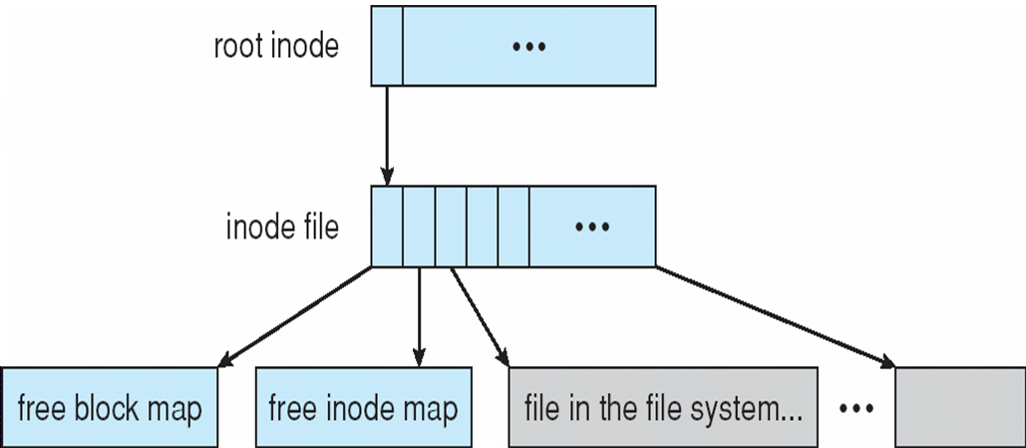
Example: WAFL File System
Similar to Berkeley Fast File System, with extensive modifications.
It is block-based and uses inodes to describe files. Each inode contains 16 pointers to blocks (or indirect間接的 blocks) belonging to the file described by the inode.
The WAFL File Layout
Notes:
inode 包含16 pointer 有紀錄檔案名稱 時間 user 而且會指向一些檔案的block 第一二三接 盡量讓檔案的block放在磁碟附近 磁頭比較不用移動

Slide 63
Example: WAFL File System
Each file system has a root inode.
A WAFL file system is a tree of blocks with the root inode as its base.
To take a snapshot照相目前狀態, WAFL creates a copy of the root inode.
Any file or metadata updates after that go to new blocks rather than overwriting their existing blocks.有修改是寫到其他地方
Used blocks are never overwritten, so writes are very fast, because a write can occur at the free block nearest the current head location.
The snapshot facility is also useful for backups, testing, versioning很像git記錄所有變動而不是覆蓋掉, and so on.

Slide 64
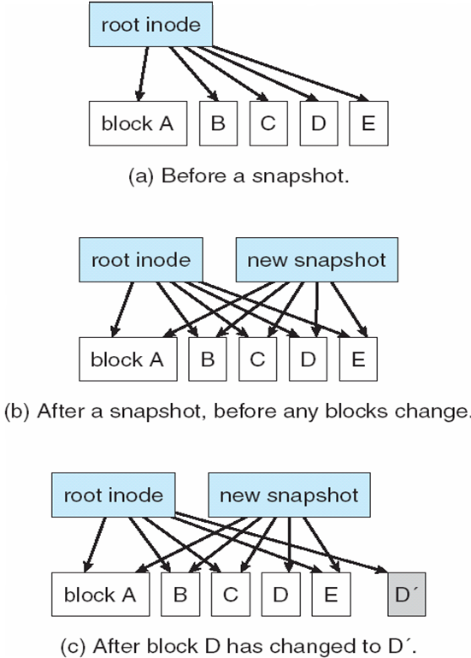
Snapshots in WAFL
A write can occur at the free block nearest the current head location
Notes:
不同snapshot就好像不同的版本的快照

Slide 65
End of Chapter 11

